Slide 1

Boosting work efficiency
Professor:
Ashish Seth
Team members
U1910071---- Naimov Fayyoz
U1910232----Kholmurodov Dilshodjon
U1910275----Komiljonov Boburjon
U1910278----Mirsagatova Sitora
U1910245----Zaynobiddinova Zebiniso

Slide 2

Content
Our presentation will include:
Overview of design process
Gantt Chart
Design Variables
QFD
Conceptual Design
Decision-Making Matrix
Final Design
Evaluation

Slide 3

Overview of Design Process
How did we manage this task???

Slide 4
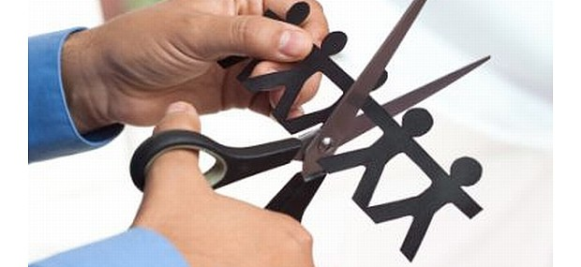
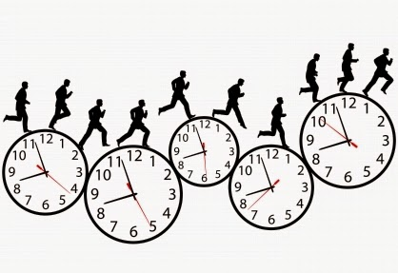
Consumer Complaints
Cutting down on employees
Lose of much time

Slide 5

Solution Solution What can be done? Create a tool that can help to workers to shorten their work Create a tool that increases efficiency

Slide 6


Consumer Complaints
Smart devices are not easy to use
Devices should not be expensive

Slide 7
Solution Solution What can be done? Create a tool that is easy to understand and use Create a tool that is not so expensive

Slide 8

Gantt Chart

Slide 9
How did we manage everything???
March 27 | March 28 | March 29 | March 30 | March 31 | April 1
General Meeting
Survey results and Design Variables |  | 1st Meeting | 2nd Meeting | 3rd Meeting
 |  | QFD Analyses |  | Decision Making Matrix | Final Design Confirmation
Conceptual Design Drafts |  |  | Conceptual Design Drafts |  | Digital Drawings
 |  |  |  | Report and PPT done

Slide 10

Design Variables

Slide 11
Design Variables
What are the essential features?
Convenience
Safety
Weight
Cost
Durability
Product should be easy to use
Product should be attractive
Product should be light to carry
Product should be cheap to purchase
Product should work for many years
Work efficiency
Product should be beneficial to the level of utility to the export/economy

Slide 12

QFD Analysis

Slide 13
QFD Analysis
What are the most important features?
 | Convenience | Design | Weight | Cost | Durability | Work efficiency
C1 | 7 | 6 | 5 | 8 | 6 | 9
C2 | 8 | 7 | 6 | 7 | 7 | 8
C3 | 7 | 5 | 7 | 8 | 6 | 8
C4 | 7 | 7 | 5 | 6 | 5 | 7
C5 | 9 | 4 | 6 | 9 | 3 | 9
Total | 38 | 29 | 29 | 38 | 27 | 41

Slide 14

Large image
Conceptual Design
How can customers use it?

Slide 15
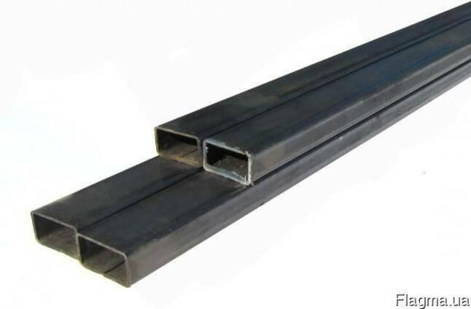
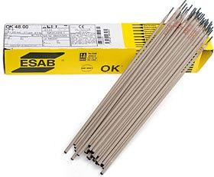
stainless profile 8$(8 metres)
Welding electrode 2$ per 2 packages

Slide 16
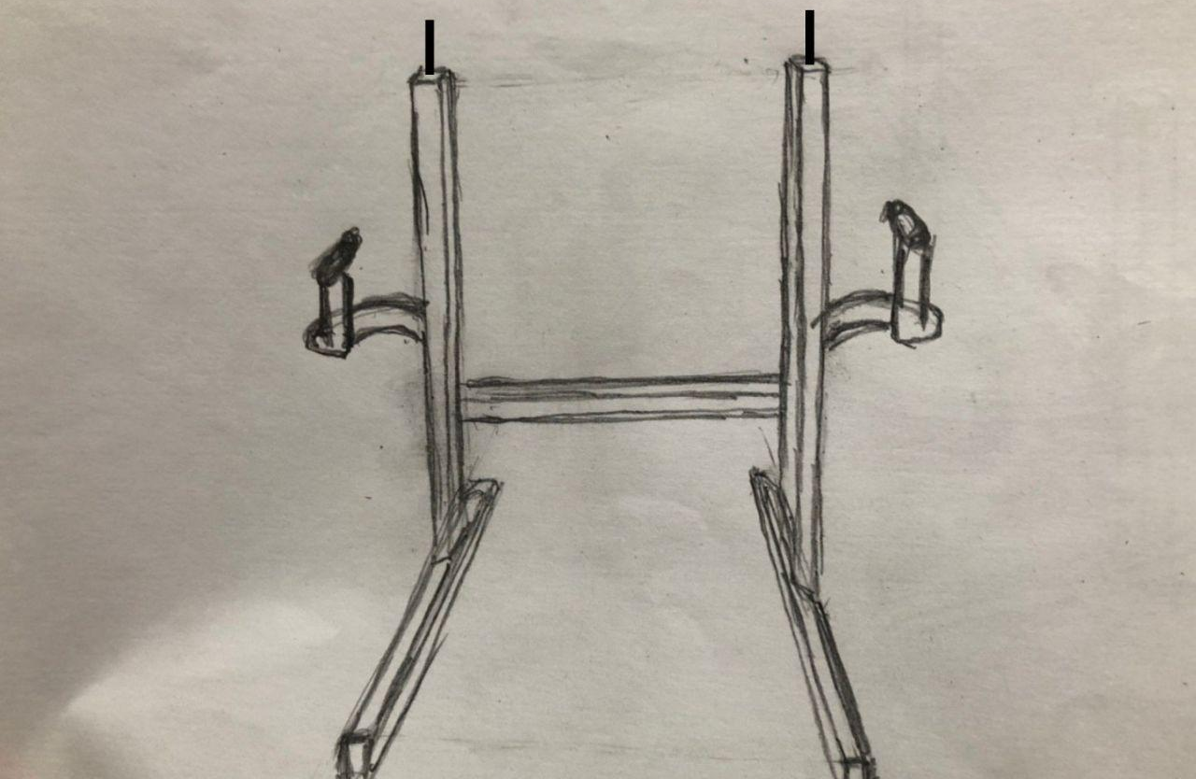
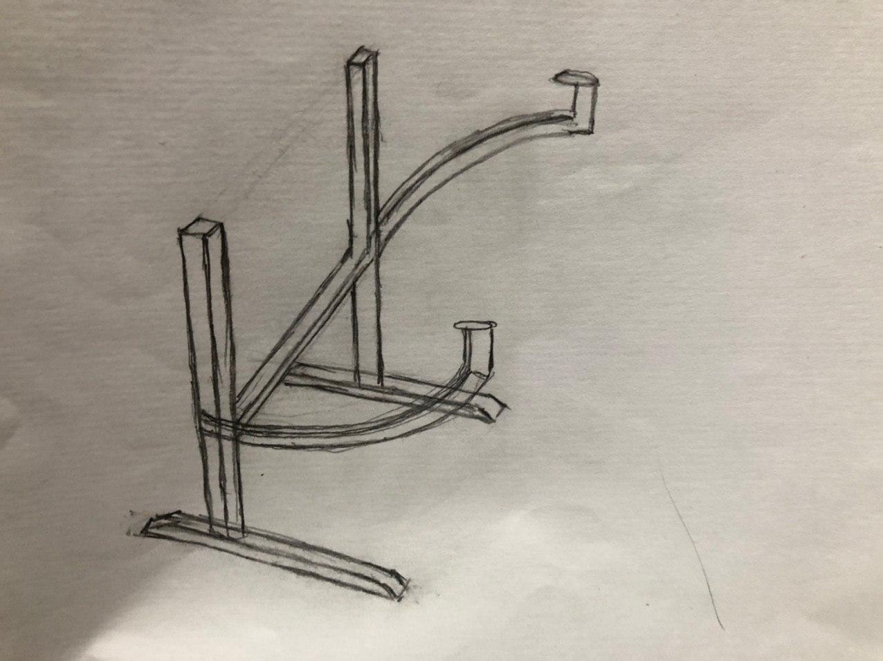

Slide 17

Solution Decision-Making Matrix

Slide 18
 | Convenience | Cost | Work efficiency
Human | 6 | 3 | 4
Our magic product | 8 | 9 | 9

Slide 19
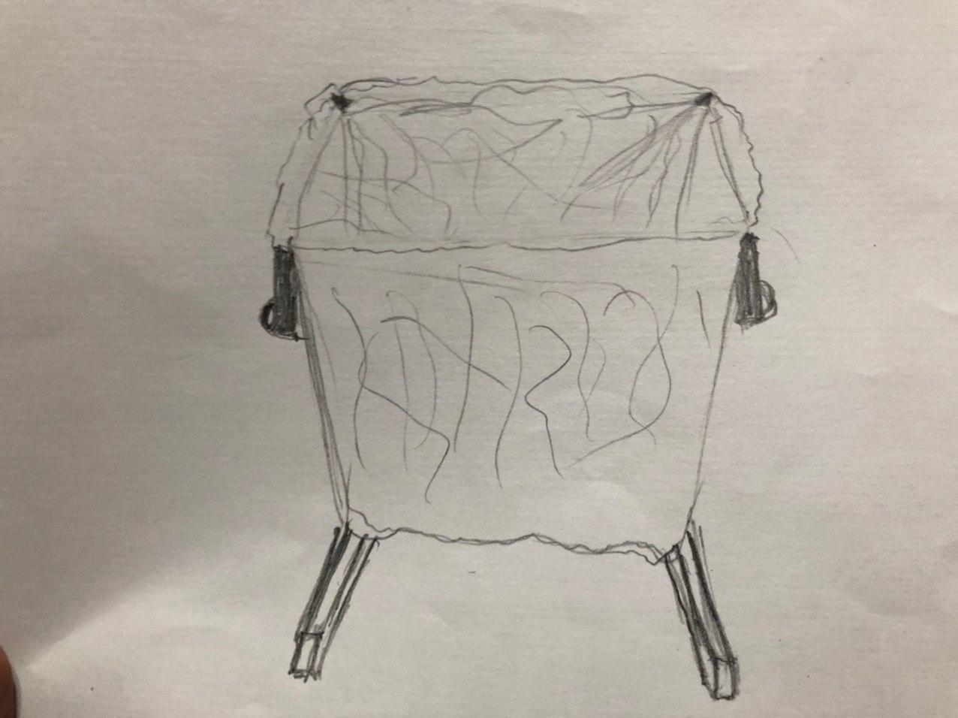
FINAL DESIGN

Slide 20

Solution EVALUATION

Slide 21
Evaluation
This product will be able to hold the bags for the workers, this will consequently increase the working efficiency and highly benefit the bussiness .
Because the product can replace the worker, the bussiness centers who are using it will not have to pay extra money for the work of staff.
One of the additional features of the following product is that the bag holder can be eather made smaller or bigger for more comfort in use.
The product will have built in wheels that will help the staff move it. This will help the users aspecially when the bag is full and the weight is too big.
As a result of the cost of investments for the product, the overall price will be cheap and will be a lot more better choice than hiring a new staff.

Slide 22

THANK YOU FOR YOUR ATTENTION!!!

